Slide 1

Interactive Excel Dashboards
With Mynda Treacy
Microsoft Excel MVP

Slide 2
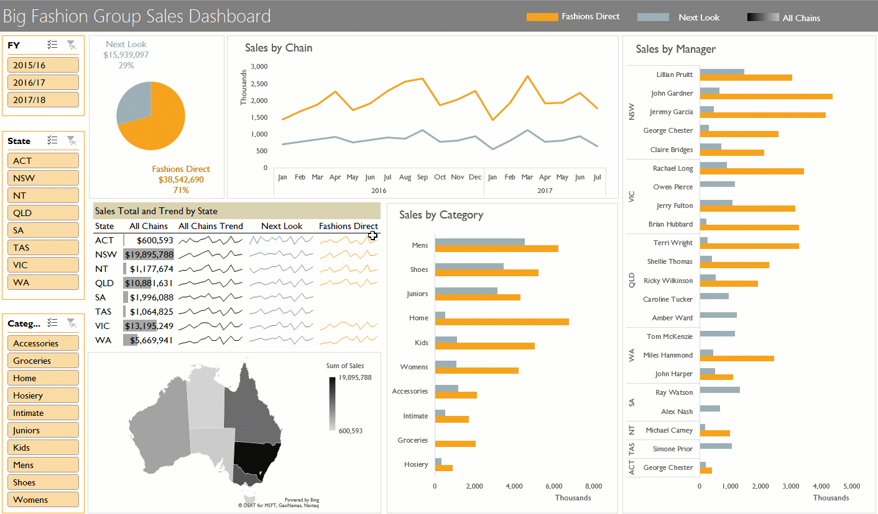
Notes:
Thank you for joining me today. I’m Mynda Treacy and I’ll be taking you through how to build the Interactive Excel Dashboard you see behind me.
I’m ready to go with my I simply Excel t-shirt on. If you want to get yourself a t-shirt like this you can buy them from Microsoft’s online store.
To quote Stephen Few; “a dashboard is a visual display of the most important information needed to achieve one or more objectives; consolidated and arranged on a single screen so the information can be monitored at a glance." but with Excel we can take them one step further and make them interactive.

Slide 3











Background
$$⤫$$
Notes:
A little background for those who don’t know me;
-I started working with Excel 22 years ago when I worked as an accountant in investment banks in London.
-I now live in Australia
-with my husband, Phil and our two boys, Conor and Finn.
-I gave up accounting 8 years ago to pursue my passion for Excel and desire to help people get more out of it, which I do through our website and blog at MyOnlineTrainingHub.com.
-I run an online Excel Dashboard course and have trained thousands of people from all over the world and from a vast array of industries.
-The last 3 years I have received the Microsoft Excel Most Valuable Professional award for my contribution to the Excel community.

Slide 4
Webinar replay and files – automatically emailed
Webinar replay and files are automatically emailed to you – no need to request them
Can’t find the replay email? – check your Junk folder or Gmail Promotions tab
If you don’t receive it within 1 hour of the webinar ending –
email us at website@myonlinetraininghub.com
If you can hear me twice, then you have the
webinar running in two tabs/browser windows
Notes:
Before we get started I just want to cover a bit of housekeeping:
-If you find your internet connection problematic, for example if the video hangs or you have audio problems, don’t worry. I’ll email you a link where you can watch the replay.
-Can’t find the replay email? – check your Junk folder or Gmail Promotions tab
-If you don’t receive it within 1 hour of the webinar ending – email us
-If you can hear me twice, then you have the webinar running in two tabs/browser windows

Slide 5
Questions
Please ask questions and give feedback in the form on the webinar page
I will answer them after the webinar ends via email
Please don’t ask for the replay or supporting files
in the Question form on this page
Notes:
-Please ask questions or leave feedback during the webinar using the form to the right of this video.
-I will answer the questions after the webinar ends via email. I just find if I stop to answer questions during the webinar it’s going to drag on, and I want to keep this as close to an hour as possible.
-Please don’t ask for the replay or supporting files here. Remember, they’ll be sent out automatically so asking for them here just wastes your time and ours.

Slide 6
What to expect
Fast Pace - you can watch the replay and download the Excel file!
How to build a Dashboard
Ideal data and workbook structure
Build fast and smart
Update in an instant
Interactive tools (Slicers)
Dynamic labelling
Notes:
I want to set your expectations for the webinar
-It’s going to be at a fast pace. You won’t have time to follow along step by step, but remember I’ll be sending an email with the links to the video replay and files.
-I’m going to teach you how to build a dashboard, obviously, right? But I want to make the distinction between building a dashboard vs dashboard design. In this webinar I’m going to focus on the mechanics of building a dashboard using the built in Excel tools – no add-ins and no VBA (btw, VBA is the programming language for Excel.
-I’ll cover the ideal data and workbook structure
-I’m going to build it fast and smart
-So I can update it in an instant
-I’ll be using Slicers to create the interactivity
-and dynamic labels that respond to selections made in the Slicers

Slide 7
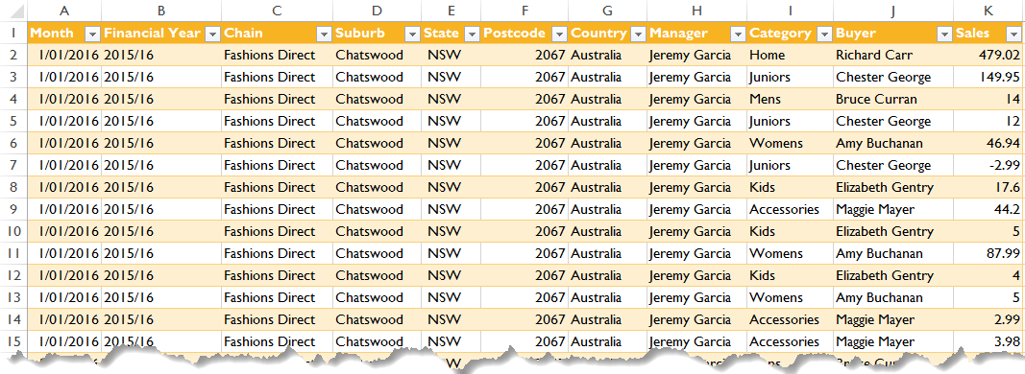
Ideal data format - Tabular
Notes:
This is the data we’ll be using. It’s over 70k rows of Sales data for two Australia wide fashion stores; Fashions Direct and Next Look.
The data spans Jan 2016 through July 2017. You can see the data is in a tabular format and is classified by date, financial year, chain, location (suburb/ state/ postcode/ country), manager, product category and product buyer.
It is formatted in an Excel Table. This is the first step in having a fast and smart build because any formulas, charts or PivotTables that reference the table automatically, or upon Refresh, pick up any changes or new data.

Slide 8
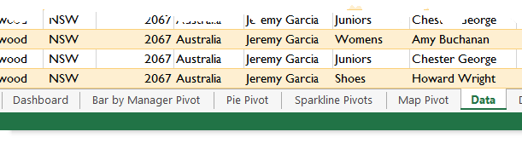
Ideal workbook layout
Separate worksheets for:
  Data
  Analysis (preferably one sheet for each PivotTable)
  Dashboard

Slide 9
Build it fast and smart
Excel Tables
PivotTables
PivotCharts
Names for:
  PivotTables
  Ranges
  Worksheets
Notes:
We’ll be employing various techniques to ensure a fast and smart build. Namely…
When we name things it makes it quick to build and easier to understand when you come back to the file 3 or 6 months later.

Slide 10
Excel version constraints
Applies to Excel 2007 onwards except for:
  Slicers – Excel 2010 onwards
  Map Charts – Excel 2016 (Office 365)
…Please wait while I move to my desk
Notes:
I’m going to be using Excel 2016 to build this dashboard but what you see will work in all versions of Excel from 2007 onwards, with the exception of:
-Slicers, which are available in Excel 2010 onwards. The alternative to Slicers is to use Combo Boxes and some VBA code. Unfortunately I won’t have time to cover this today but teach them in my online Excel dashboard course.
-Map Charts – these are a new feature available to Office 365 Excel 2016 users. Again, I won’t have time to cover any alternatives for those of you who don’t have Office 365, but the map chart is really a small part of the dashboard and the reason I included it was to show you this new feature, as opposed to it being a mandatory part of a dashboard.
-Ok, let’s get started. Give me a second while I move to my desk.

Slide 11
What next…
  Replay video and files automatically emailed in the coming hour
  Just the beginning…
Notes:
-Ok, I know I ran through building that dashboard quite fast but I’ll be emailing you with a link where you can watch the replay at your own pace plus download the Excel file and PowerPoint presentation from the webinar which contains links to more resources. Plus it’ll include a link to my Chart Recipe eBook.
-Unfortunately I’ve only been able to touch the surface of what’s possible with Excel Dashboards in this webinar because of the time constraint but my hope today is that you’ve picked up a few tips as well as experienced the power of Excel for building dashboards.

Slide 12
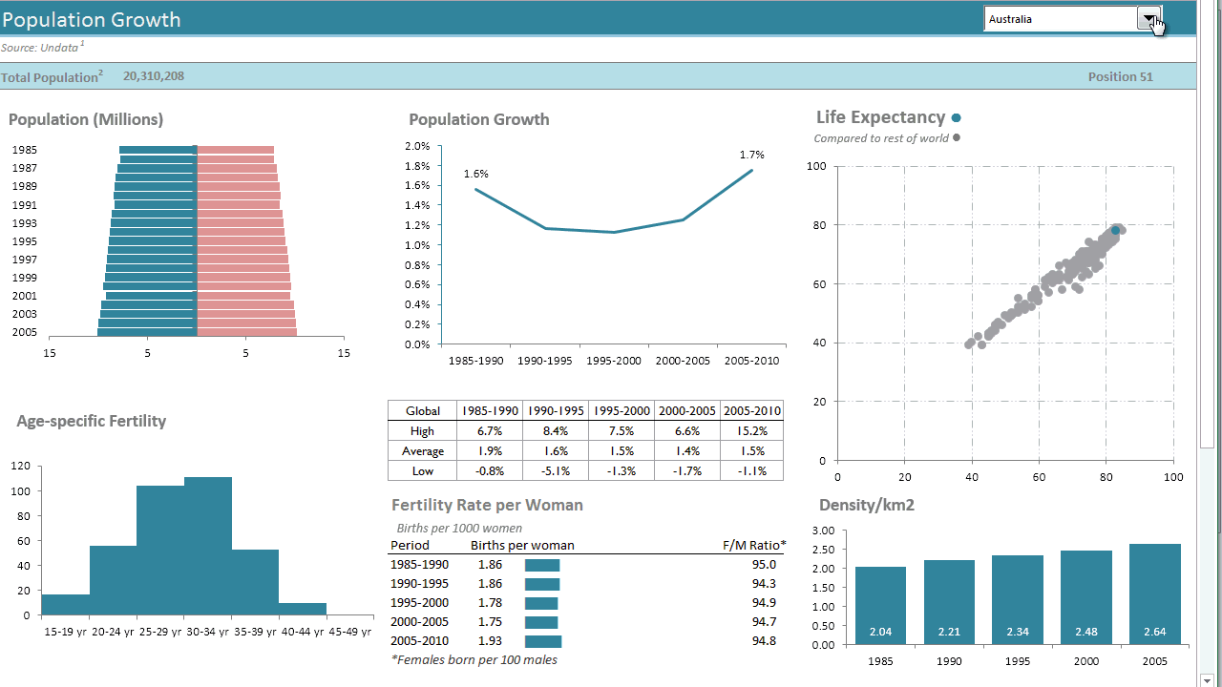
Notes:
Although the dashboard I just built used PivotTables for the analysis, if you’re more of a formula fan then I teach you how to create the same interactivity with formulas and data validation or combo boxes as you can see here, so don’t feel you have to know PivotTables to create a dashboard in Excel. Plus when you set up your formulas so they’re linked to data stored in Excel Tables they will also update your Dashboard report as soon as you paste in the new data so updating them can be just as quick, if not quicker than I’ve shown you today.

Slide 13

Excel Dashboard Course
Notes:
If you’d like set yourself apart from the crowd and get the skills required to build Excel Dashboards so you can wow your boss and colleagues;

Slide 14
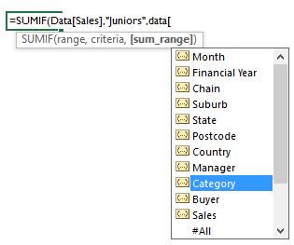
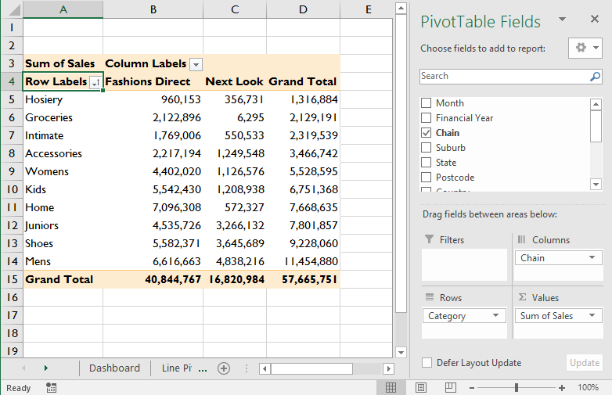
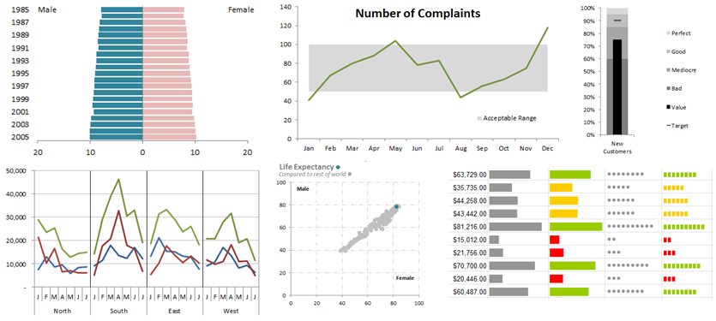
Excel Dashboard Course
Notes:
-Skills like PivotTables,
-how to write formulas that update themselves
-and charting, plus pick up various tips and tricks like I’ve shown you today then please consider my online Excel Dashboard course. There’s a link on the webinar page where you can register and get more information on the course.

Slide 15
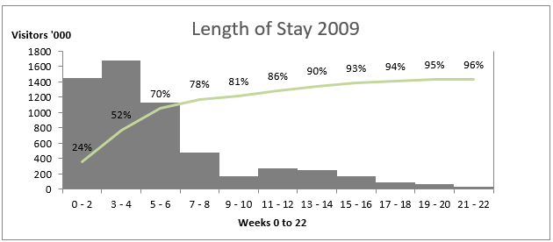
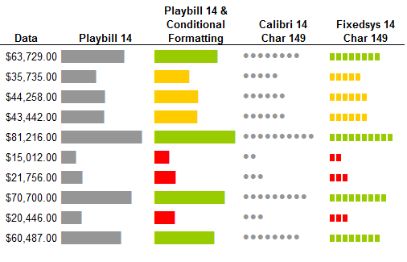
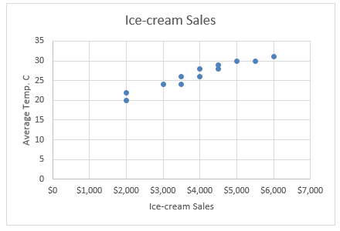
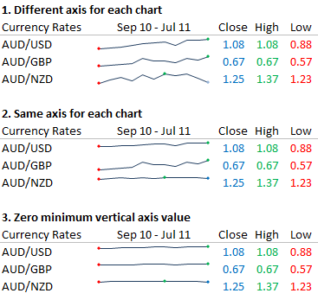
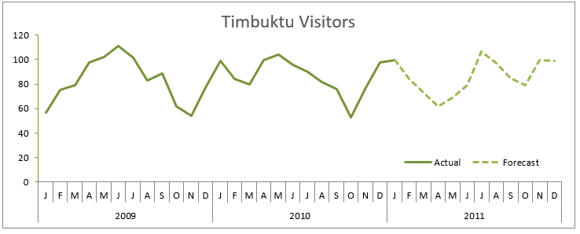
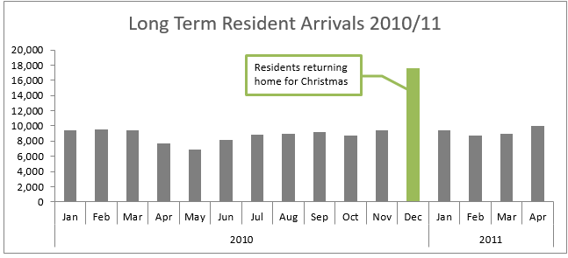
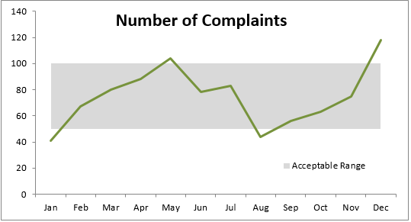
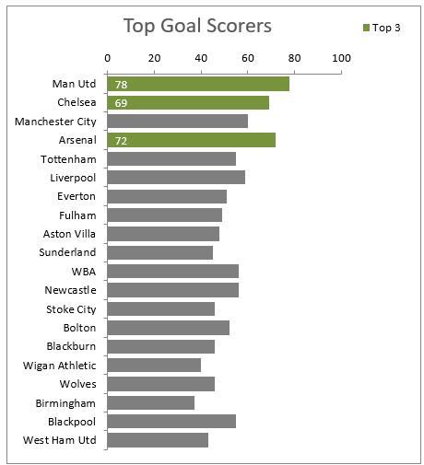
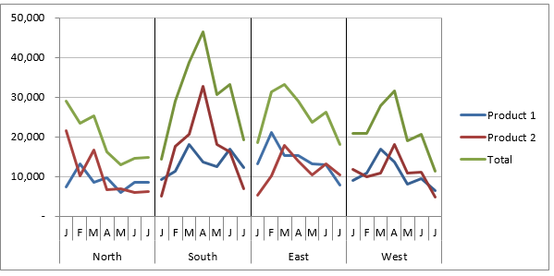
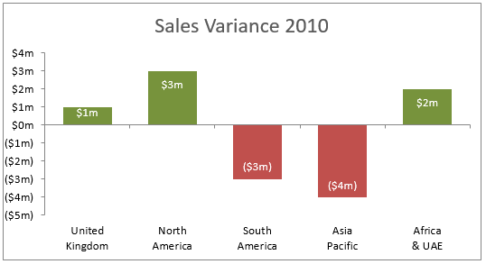
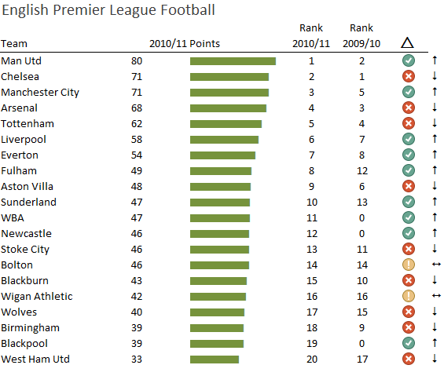
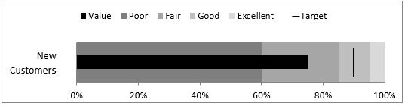
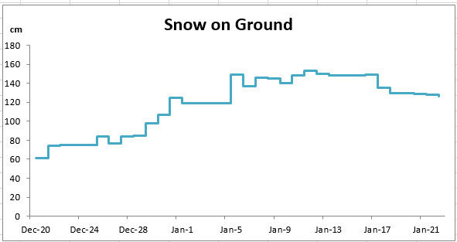
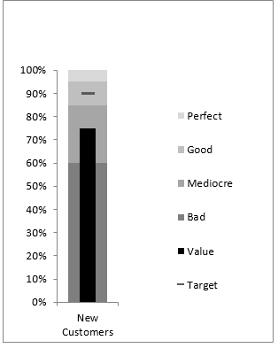
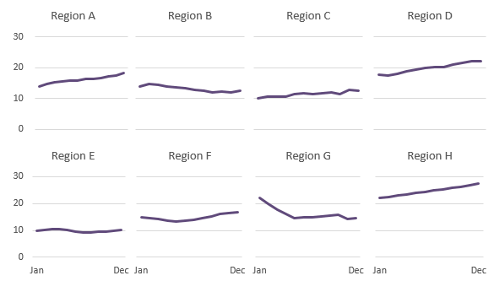
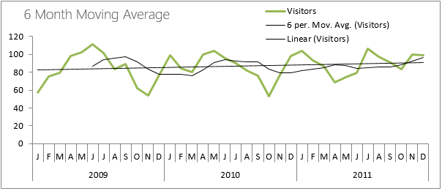
Notes:
In the course I go into step by step detail on how to build dashboards in Excel, including over 20 different charts, most of which you won’t find in the chart menu.

Slide 16
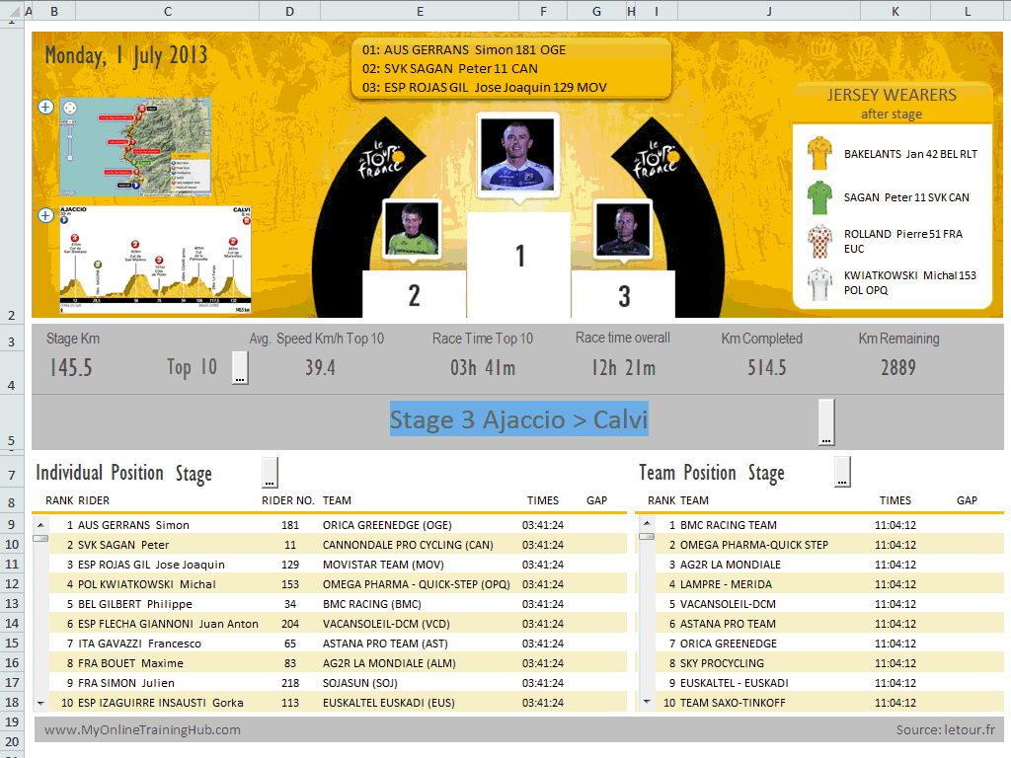
Notes:
I cover how to use form controls and data validation linked to formulas to create interactive dashboards, plus I give you some VBA code so you can create some amazing animations like the ones in my le Tour de France dashboard you see here.
And don’t worry if you don’t already have PivotTable, charting or formula skills because I include all of this step by step training in my online dashboard course so you can get your Excel skills up to date, and learn how to use them to create amazing interactive dashboards in the one course.

Slide 17
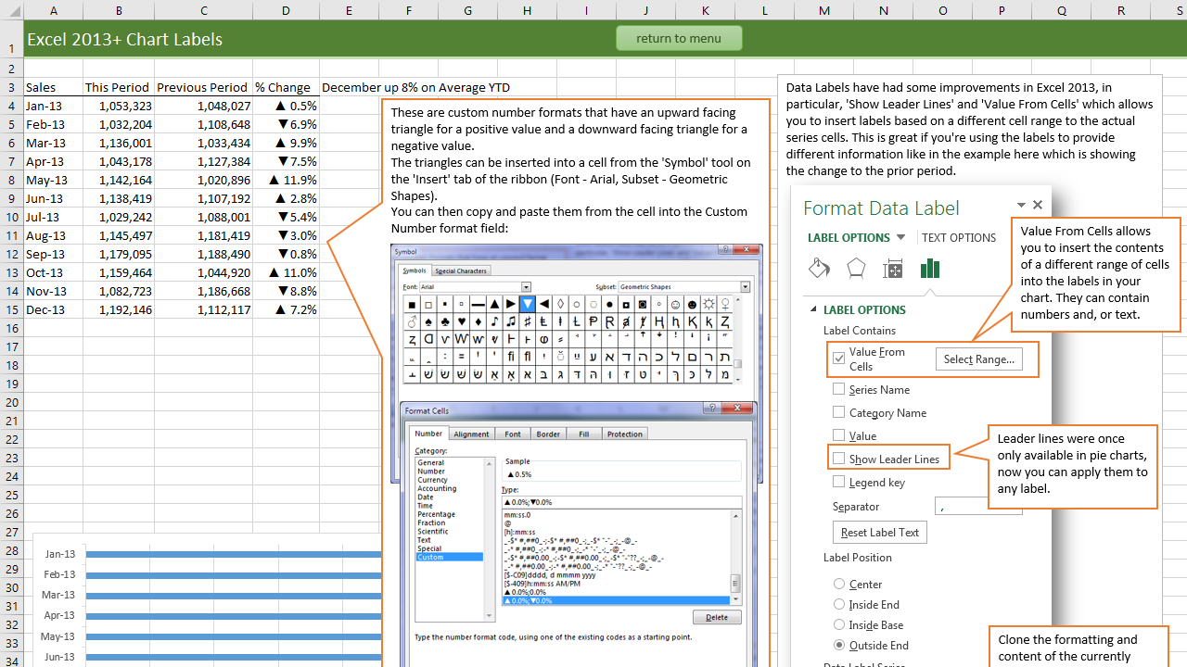
Supporting files
Notes:
The workbooks contain extensive notes so you can use them to refresh your memory or even skim read if you’re in a hurry.

Slide 18
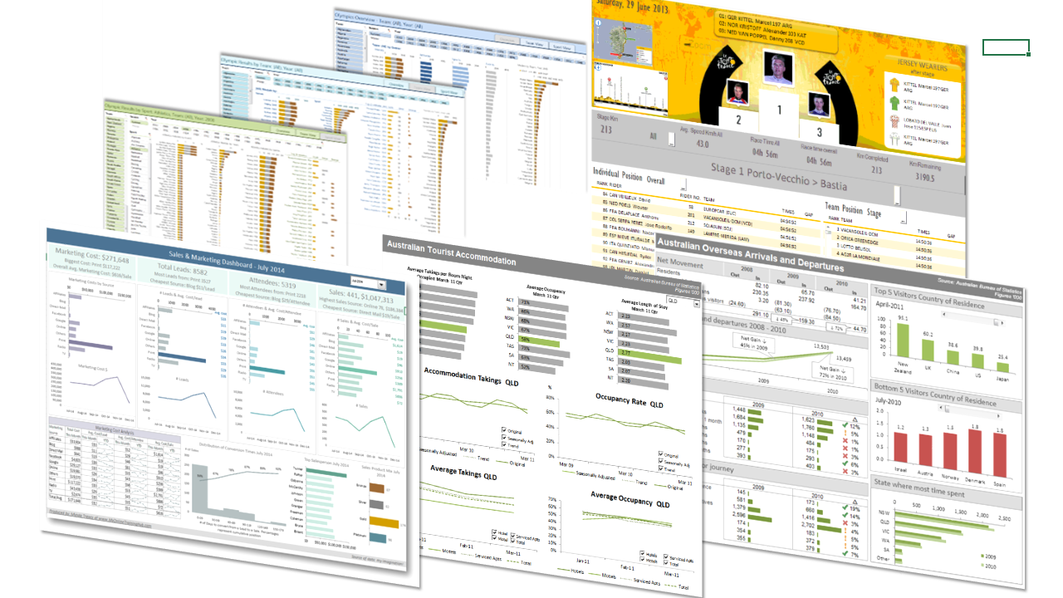
Course format
Notes:
Plus I give you these 5 sample Excel dashboards which you can learn from and steal ideas.

Slide 19
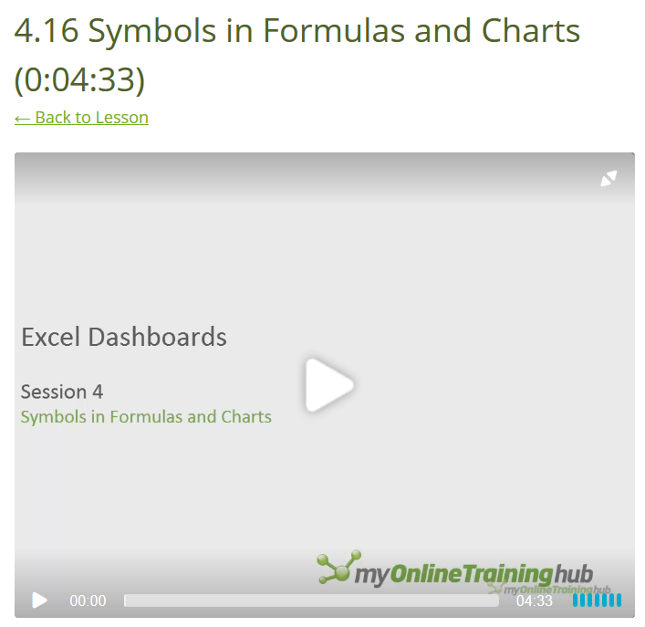
Course format
  Short videos – average 5 minutes
  Self-paced – available 24/7
Notes:
Unlike the webinar today, the videos in my online course are all short,
-on average 5 minutes long
-and the course is self-paced so you can watch it when it suits you.

Slide 20
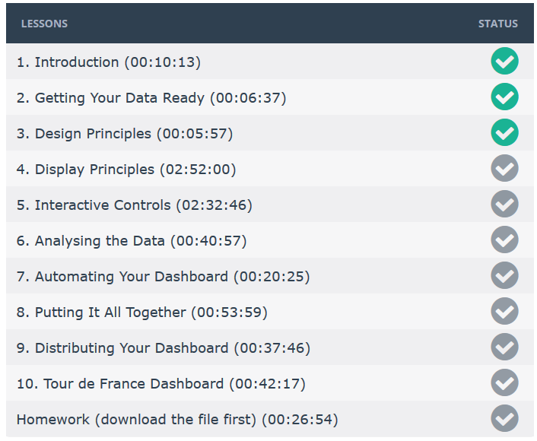
Course format
Notes:
You can keep track of your progress in our Learning Management system

Slide 21

Notes:
which automatically issues you with a Certificate of Completion at the end.

Slide 22
Course feedback
I finally completed the Dashboard course. Can’t wait to hang my Certificate on the office wall. Looking forward to using all the wonderful tips & tricks in my upcoming reports. Thank you very much for this wonderful course. It is the most beneficial course I have ever taken before.
This was the best Excel course I have ever taken. It was so good that I ordered the videos for future reference. I have used the course to build a dashboard that has been well received.
I already reviewed all 10 sessions of your Excel Dashboard course. You are genius. You provide all methodologies, tools & tips in very organized way & logical sequences.
Most of my questions in past 15+ years working with Excel were answered one at the time when I went through your training.
Based on the dashboard prototype I was able to create while just half way through the course, our commercial dashboard vendor decided to poach my concept and design and incorporate in their standard product!
Notes:
The feedback from my online course has been amazing. I continually get emails from my members with comments like…
There are plenty more testimonials like that on the dashboard course registration page so I won’t go on.

Slide 23
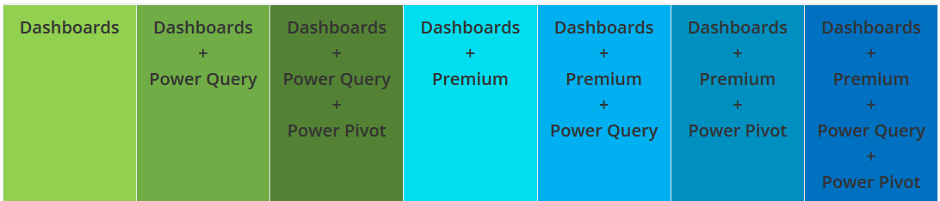
Discounted course bundles
Email: website@MyOnlineTrainingHub.com
Notes:
BTW, you can also get my Dashboard course in a discounted bundle with some of our other courses including Power Query, Power Pivot and our Premium Excel, Word and Outlook training.
And if you register by July 7 it’s an extra 20% off
If you have any questions be sure to pop them in the form on this webinar page or email me at website@myonlinetraininghub.com and I’ll get back to you ASAP.
Thanks for your time today.

